Slide 1
Angular WebApp Security with OAuth2
( Reverse engineering Jhipster Generated Code )
arnaud.nauwynck@gmail.com
this document: https://github.com/Arnaud-Nauwynck/Presentations/Web/
Security-OAuth2-Angular-ReverseEngineering-Jhipster

Slide 2
Comparison Only with the JWT Mode
This document focus on comparisons
of the default "JWT" mode "OAuth2" Mode
For more detailed screenshots => please see document part 1

Slide 3
Step 1: re-generate ANOTHER Jhipster project with same name
# check already install globally
npm install -g generator-jhipster
# create a new empty dir
mkdir demo-oauth2
cd demo-oauth2
# launch jhipster generator
jhipster

Slide 4
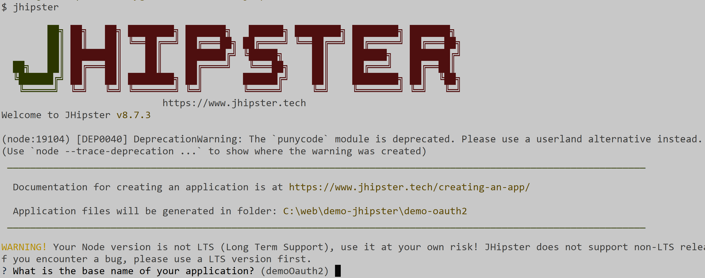
jhipster
when prompted for project name (inferred for current directory name) => change to be same as "demo" project
instead of "demo-oauth2"

Slide 5
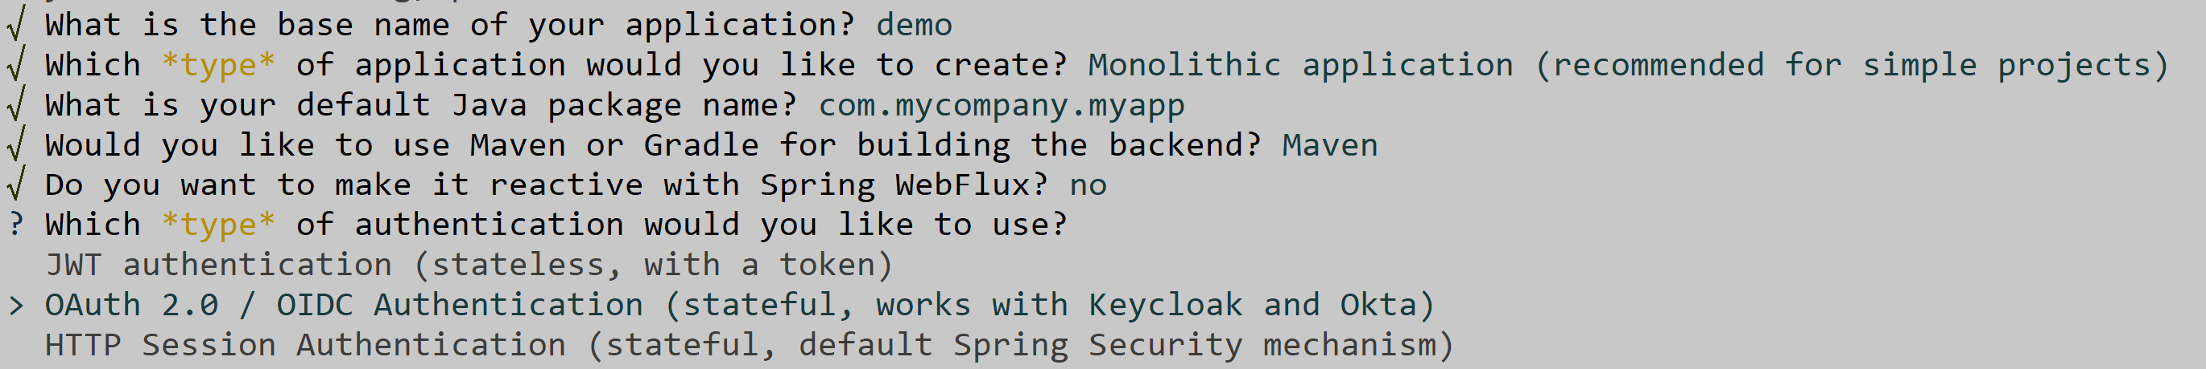
on question "Which type of authentication.. ?" change from default choice #1 to choice #2: OAuth2

Slide 6
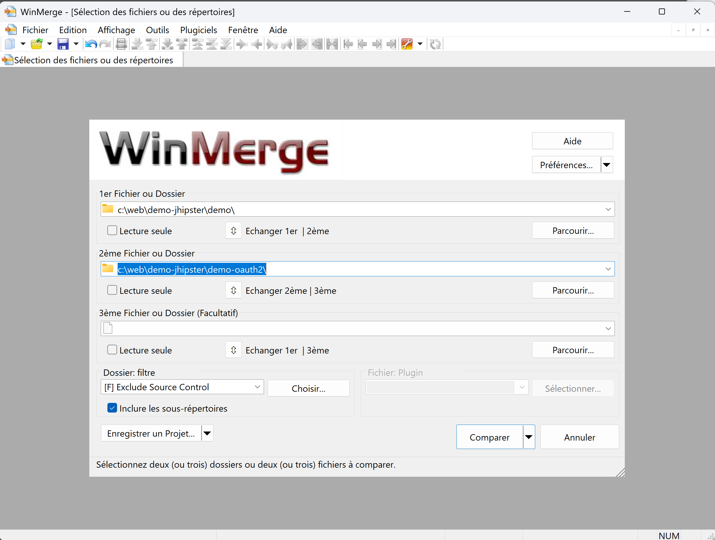
Comparing (WinMerge) Generated Apps JWT <-> OAuth2

Slide 7
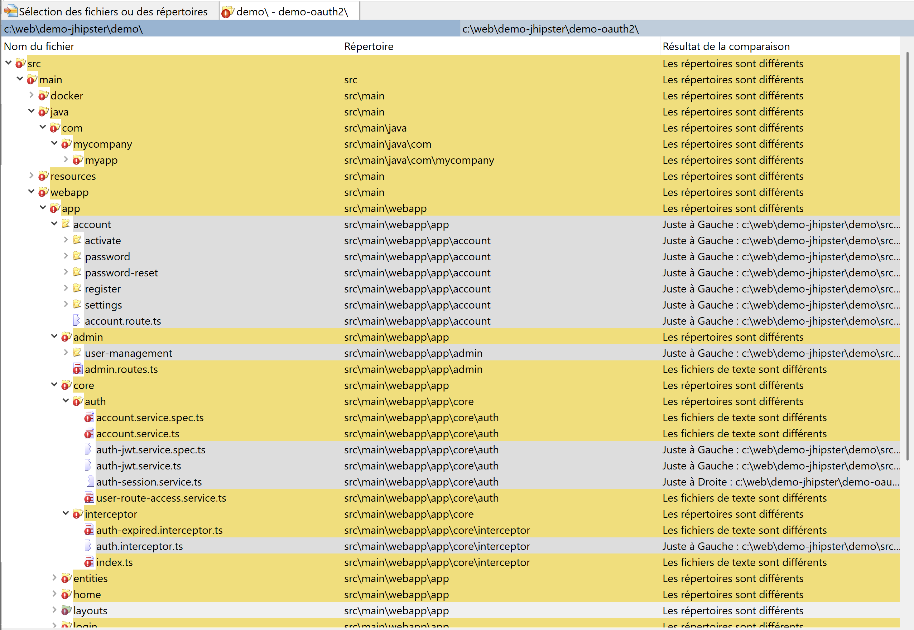
Differences JWT <-> OAuth2

Slide 8
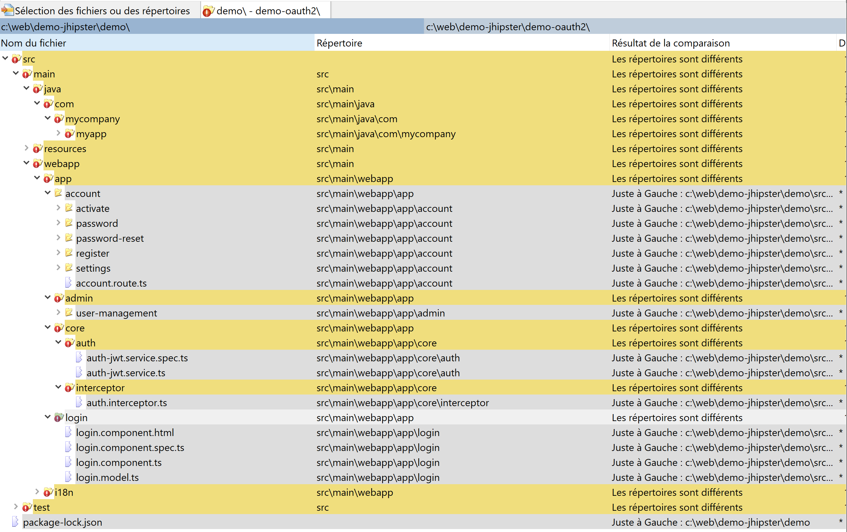
Files Only in "JWT" mode

Slide 9
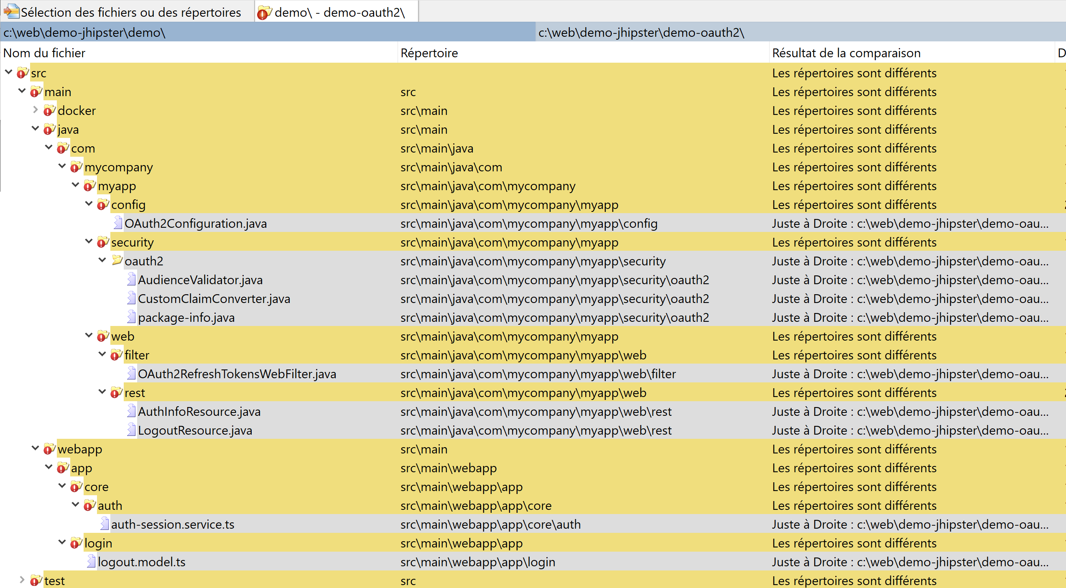
Files Only in "OAuth2" Mode

Slide 10
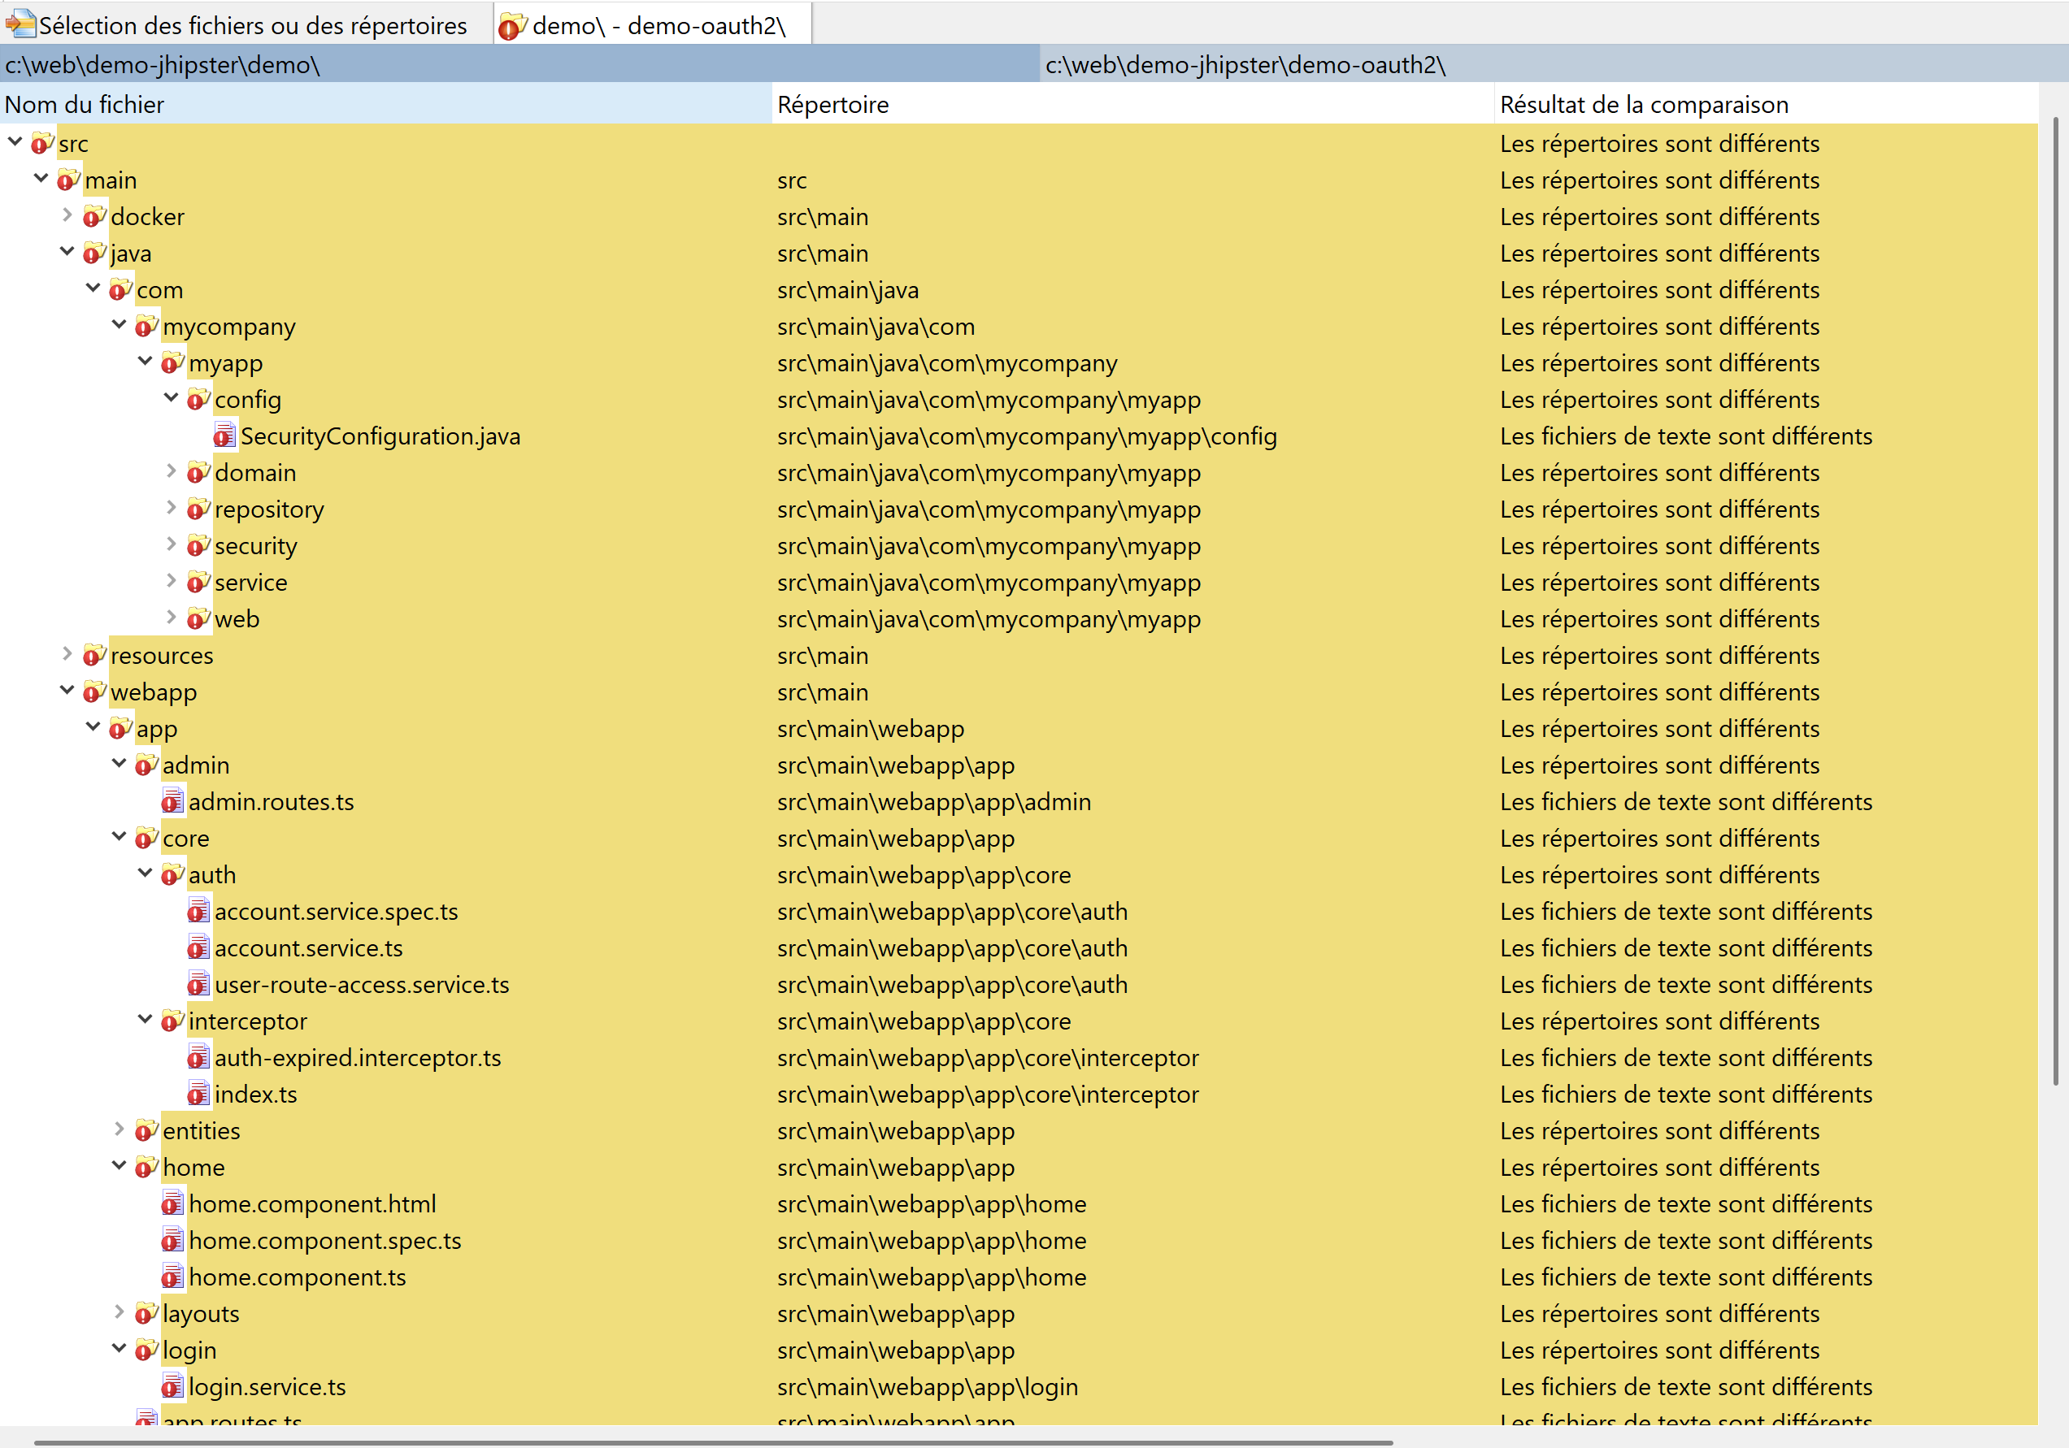
Different Files (maybe not for auth mode)

Slide 11
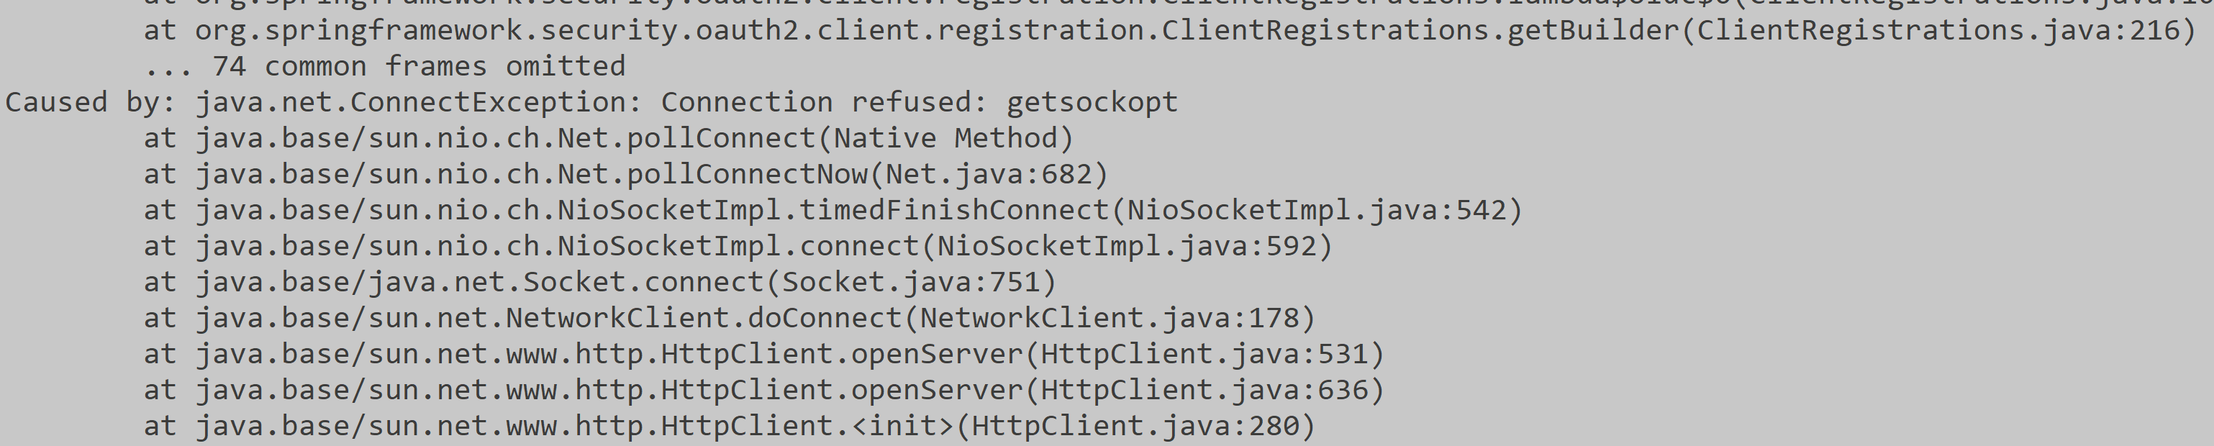
Launching Backend: mvn -Pdev,tls spring-boot:run ( instead of mvn -Pdev spring-boot:run ) for https:// instead of http://

Slide 12
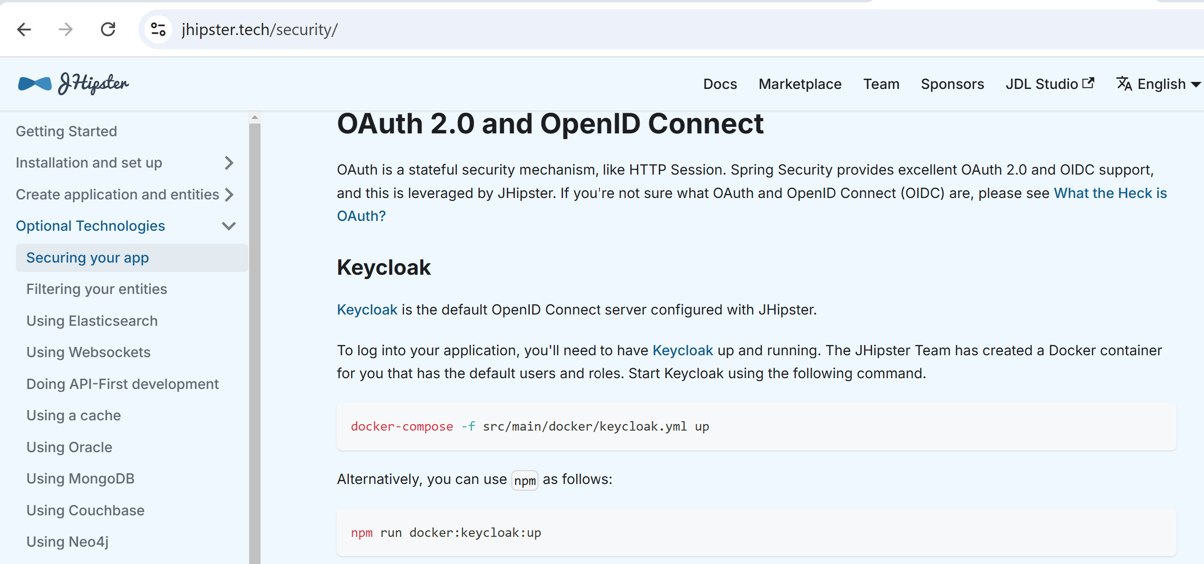
Need to Launch the OAuth2 Server https://jhipster.tech/security

Slide 13
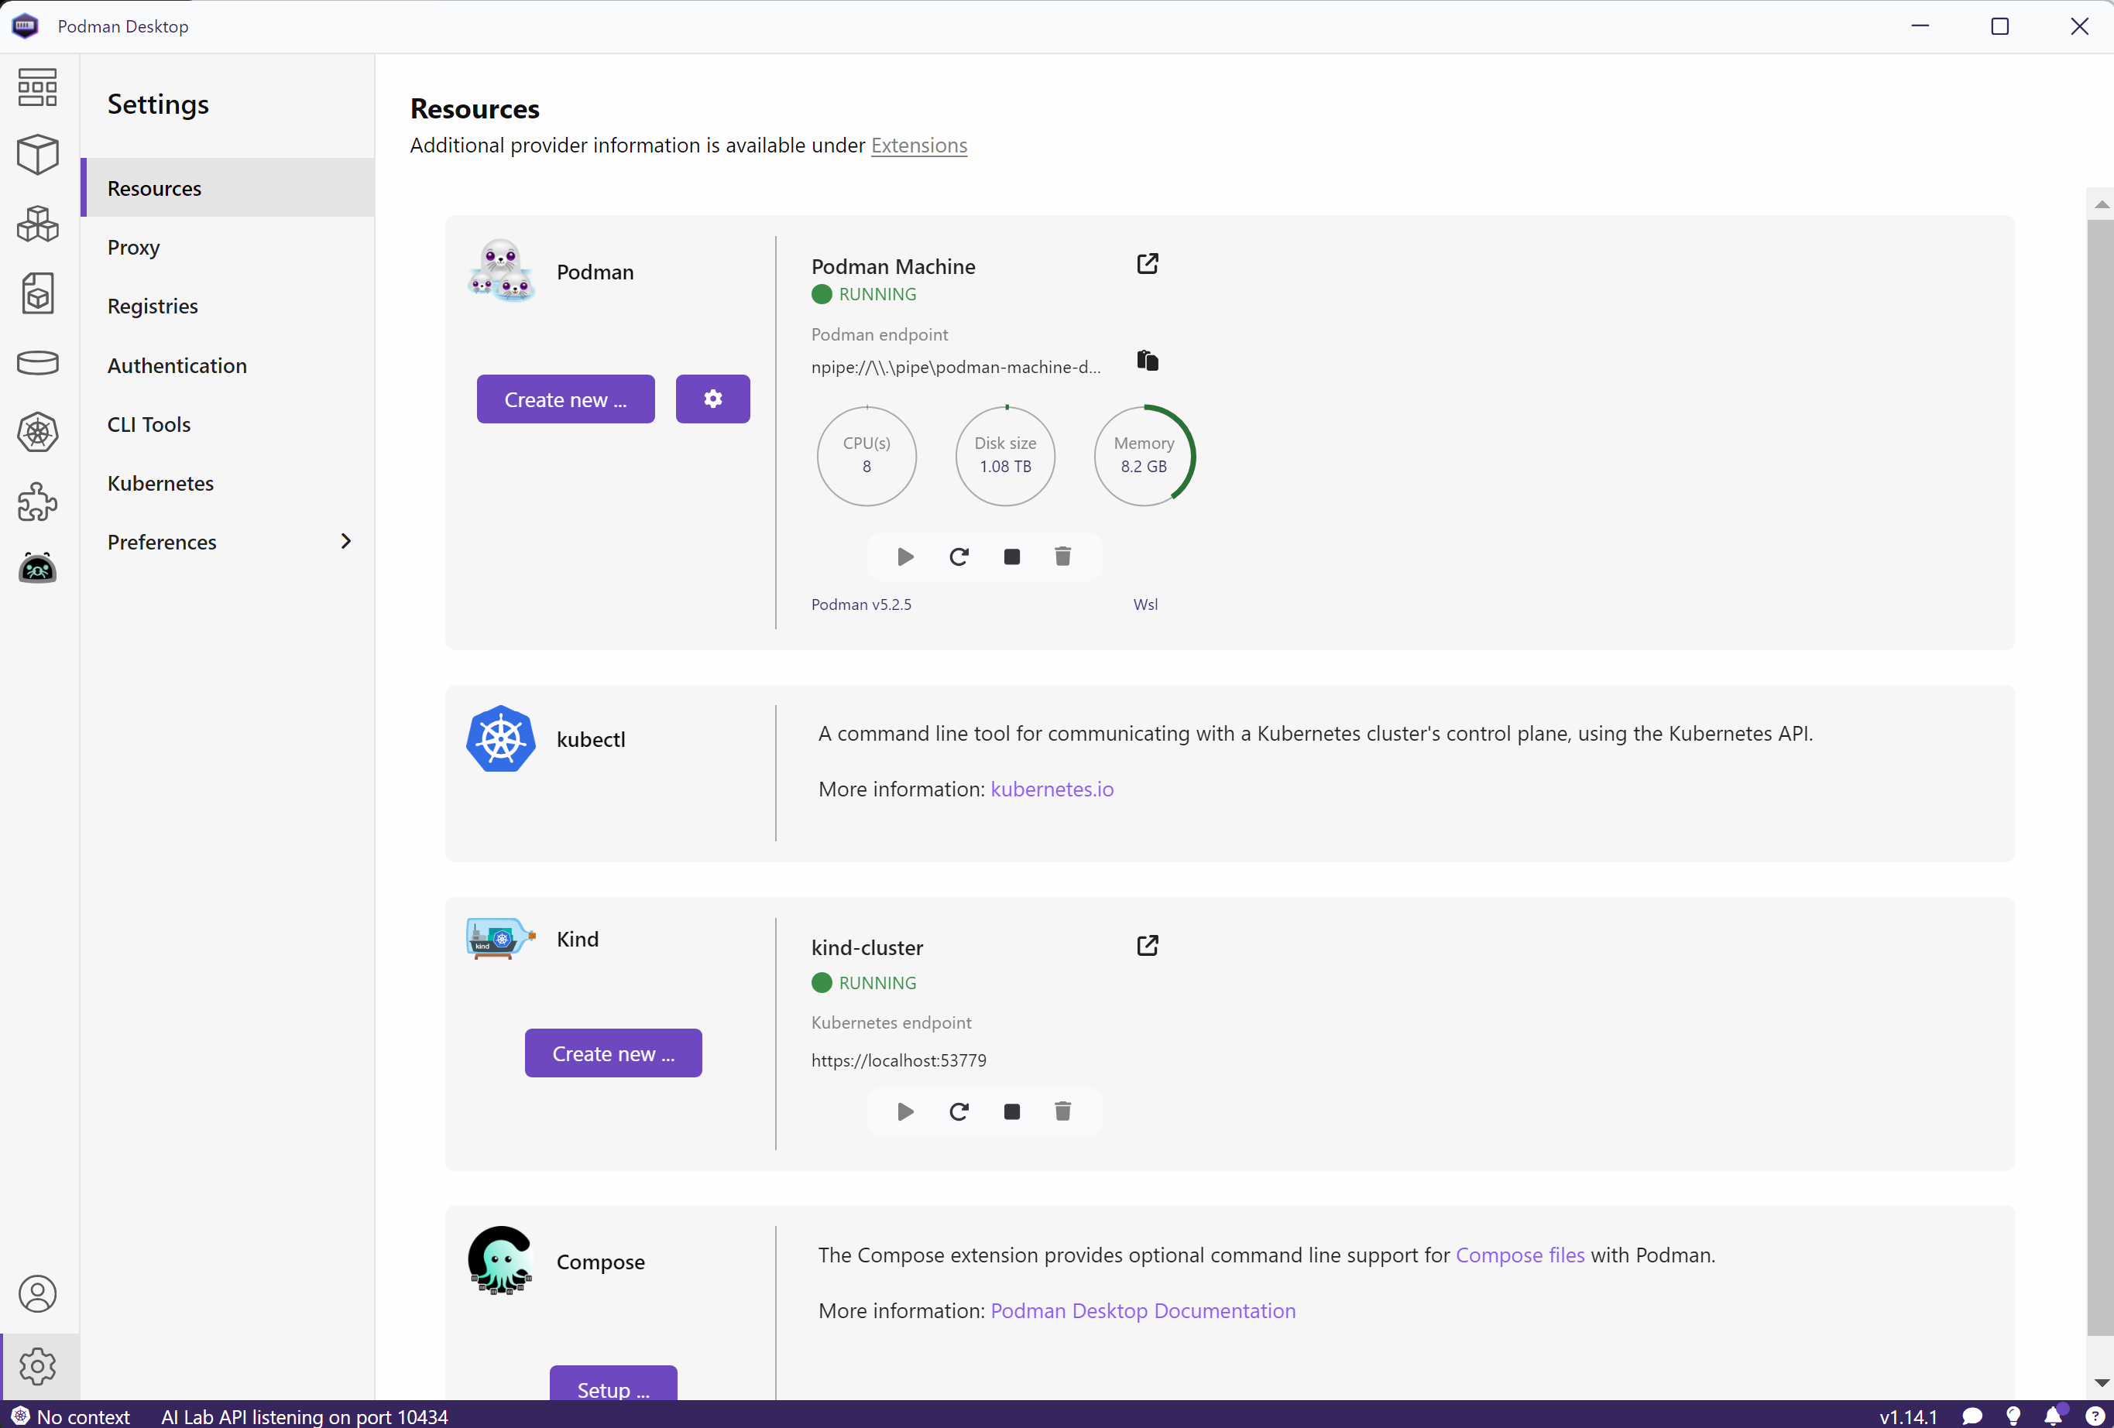
Starting Docker (Podman + Kubernetes)

Slide 14
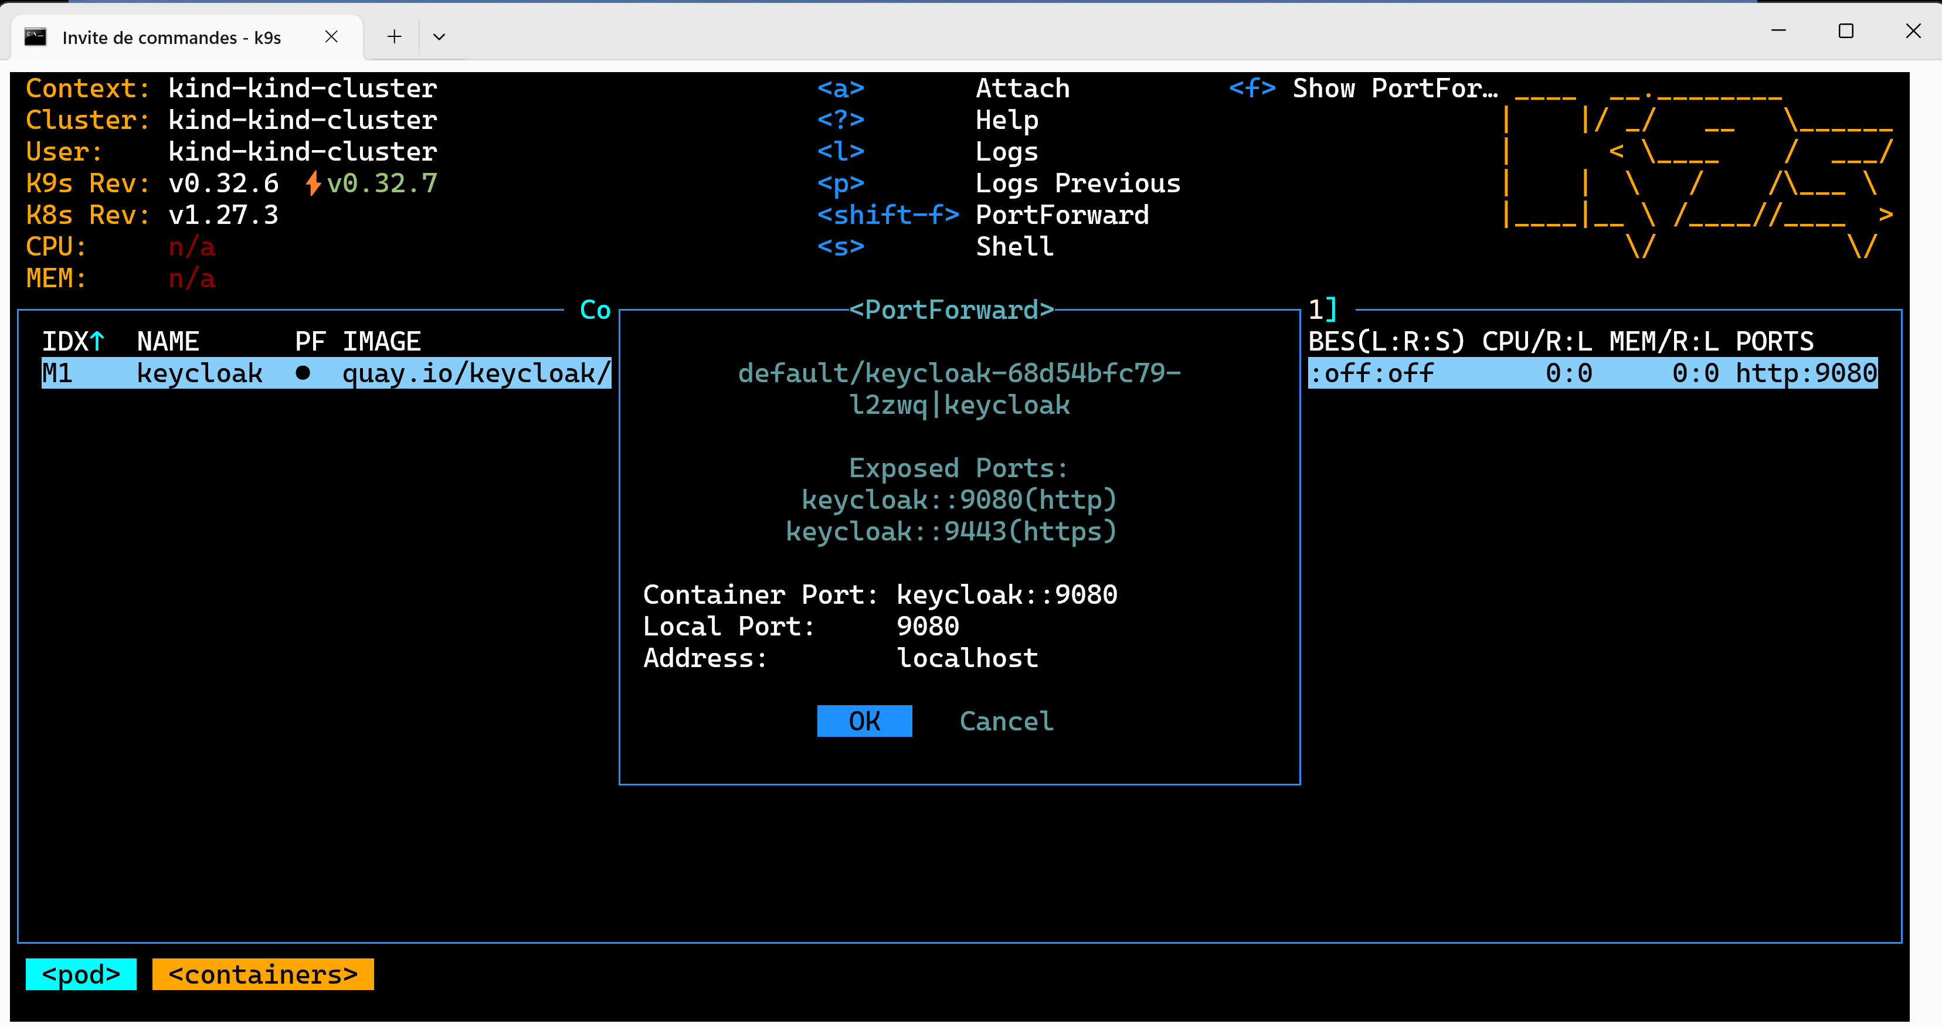
launched using Kubernetes + Port-Forward

Slide 15
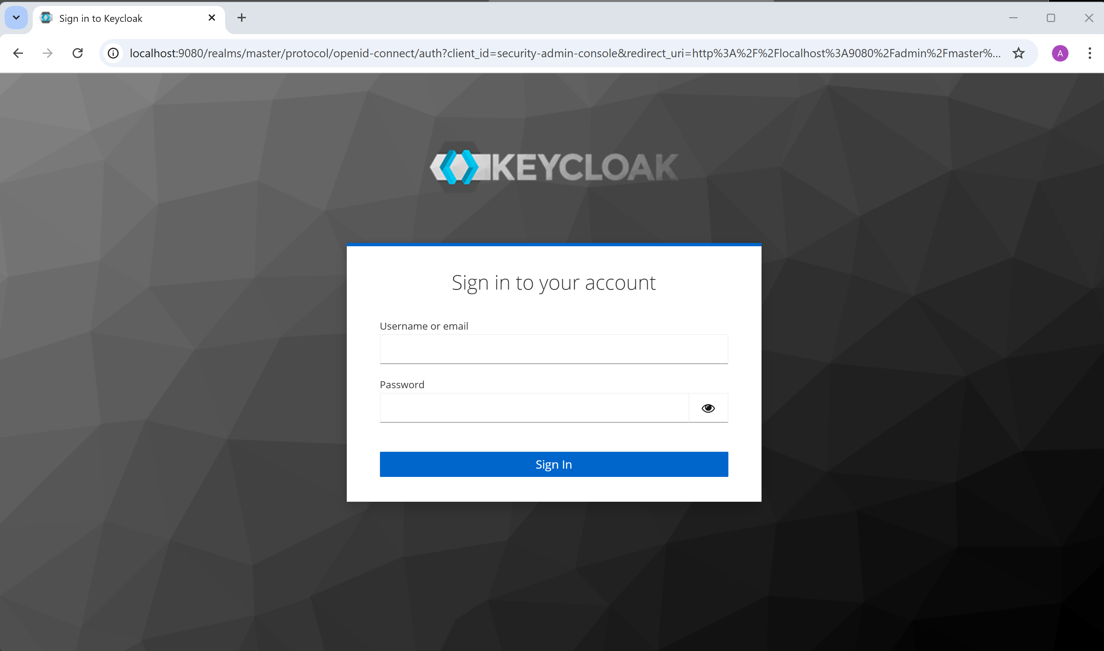
http://localhost:9080

Slide 16
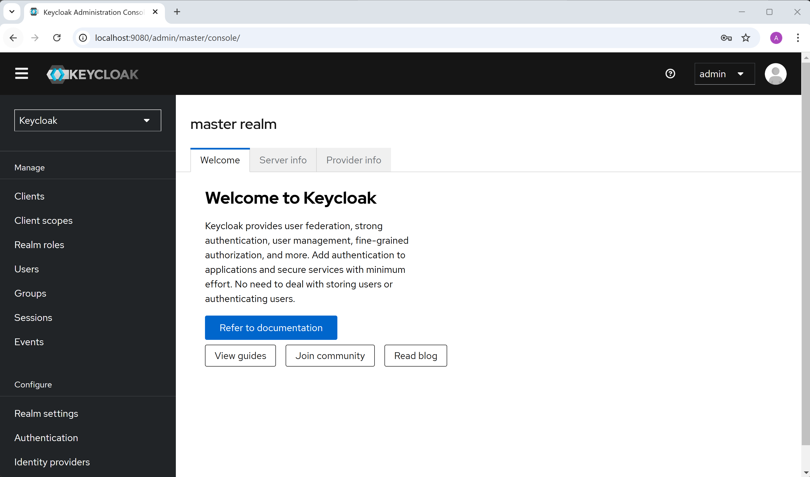
login admin/admin .. check "realm"

Slide 17
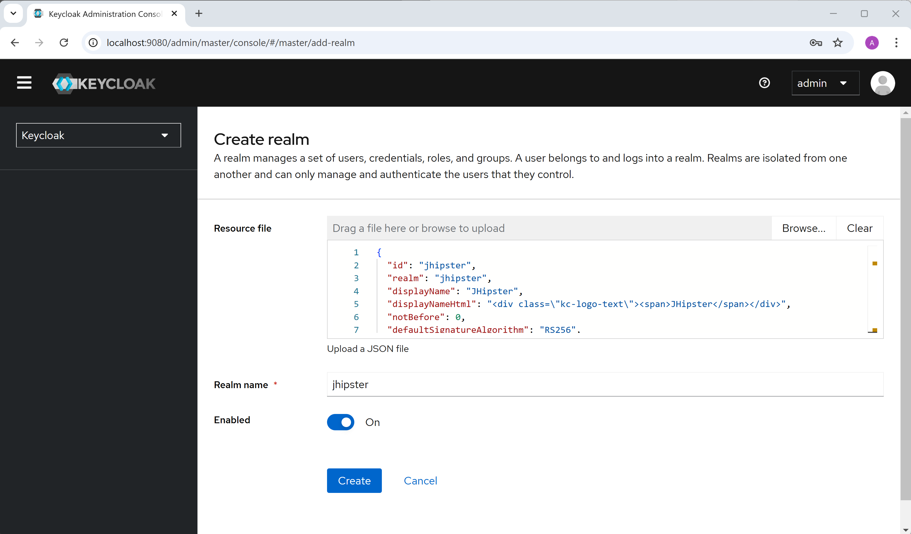
Create Realm - import jhipster-realm.json

Slide 18
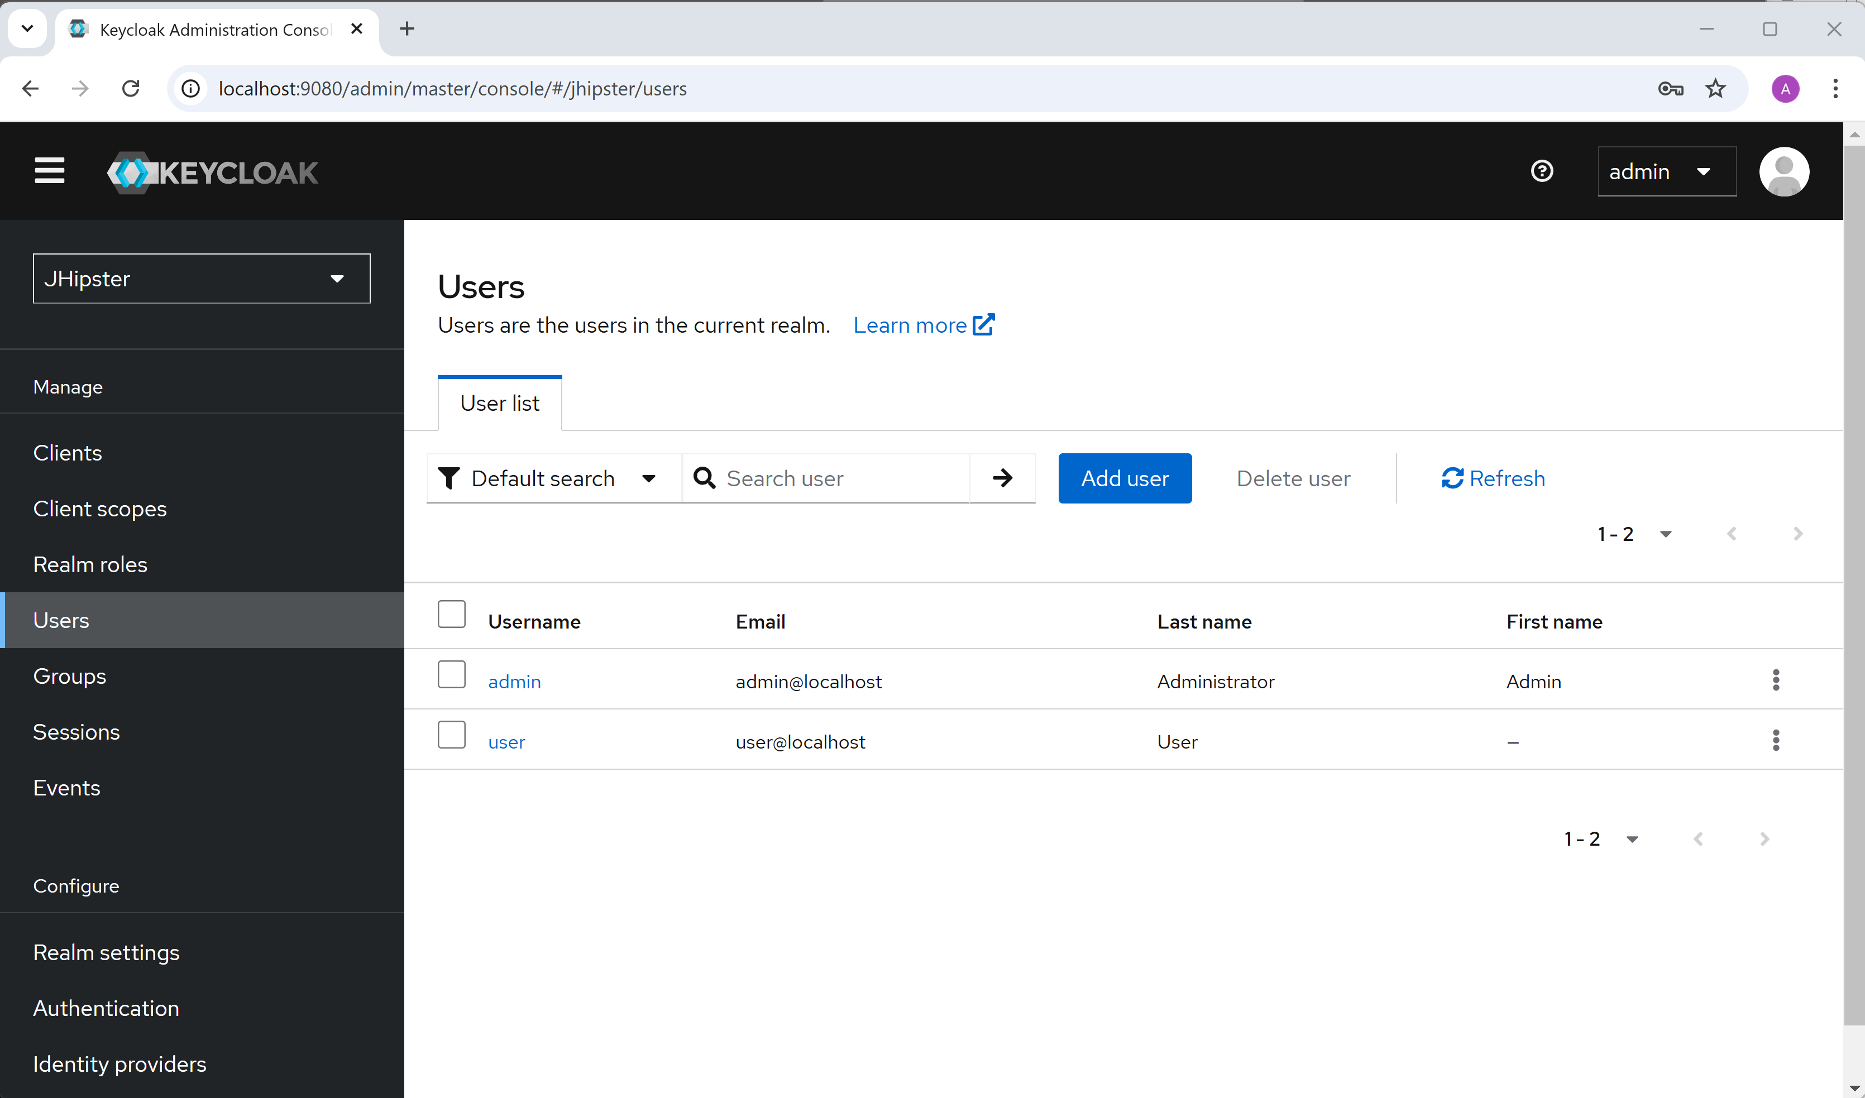
JHipster Realm : users

Slide 19
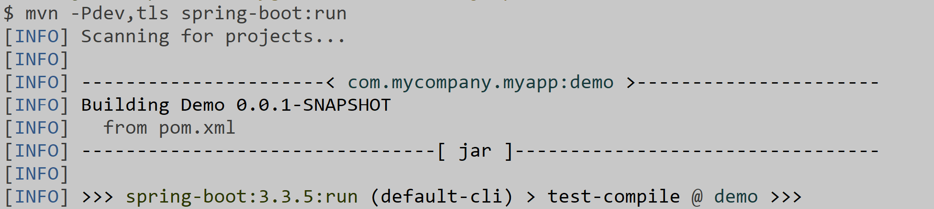
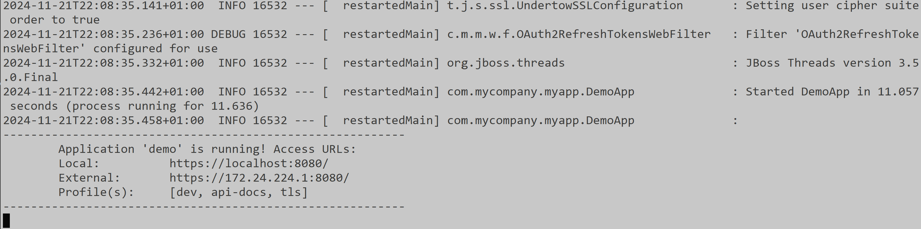
Now can restart backend

Slide 20
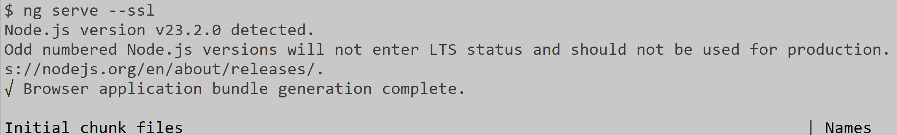
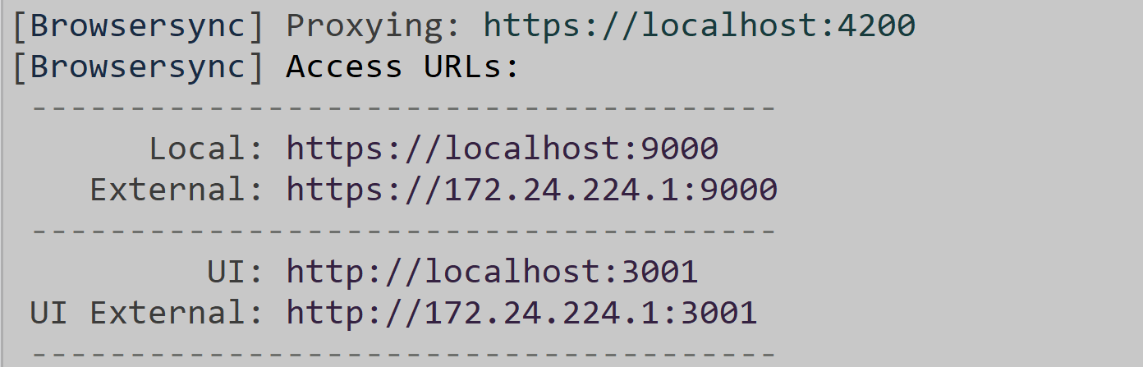
Launching Frontend: ng serve --ssl (instead of "ng serve")

Slide 21
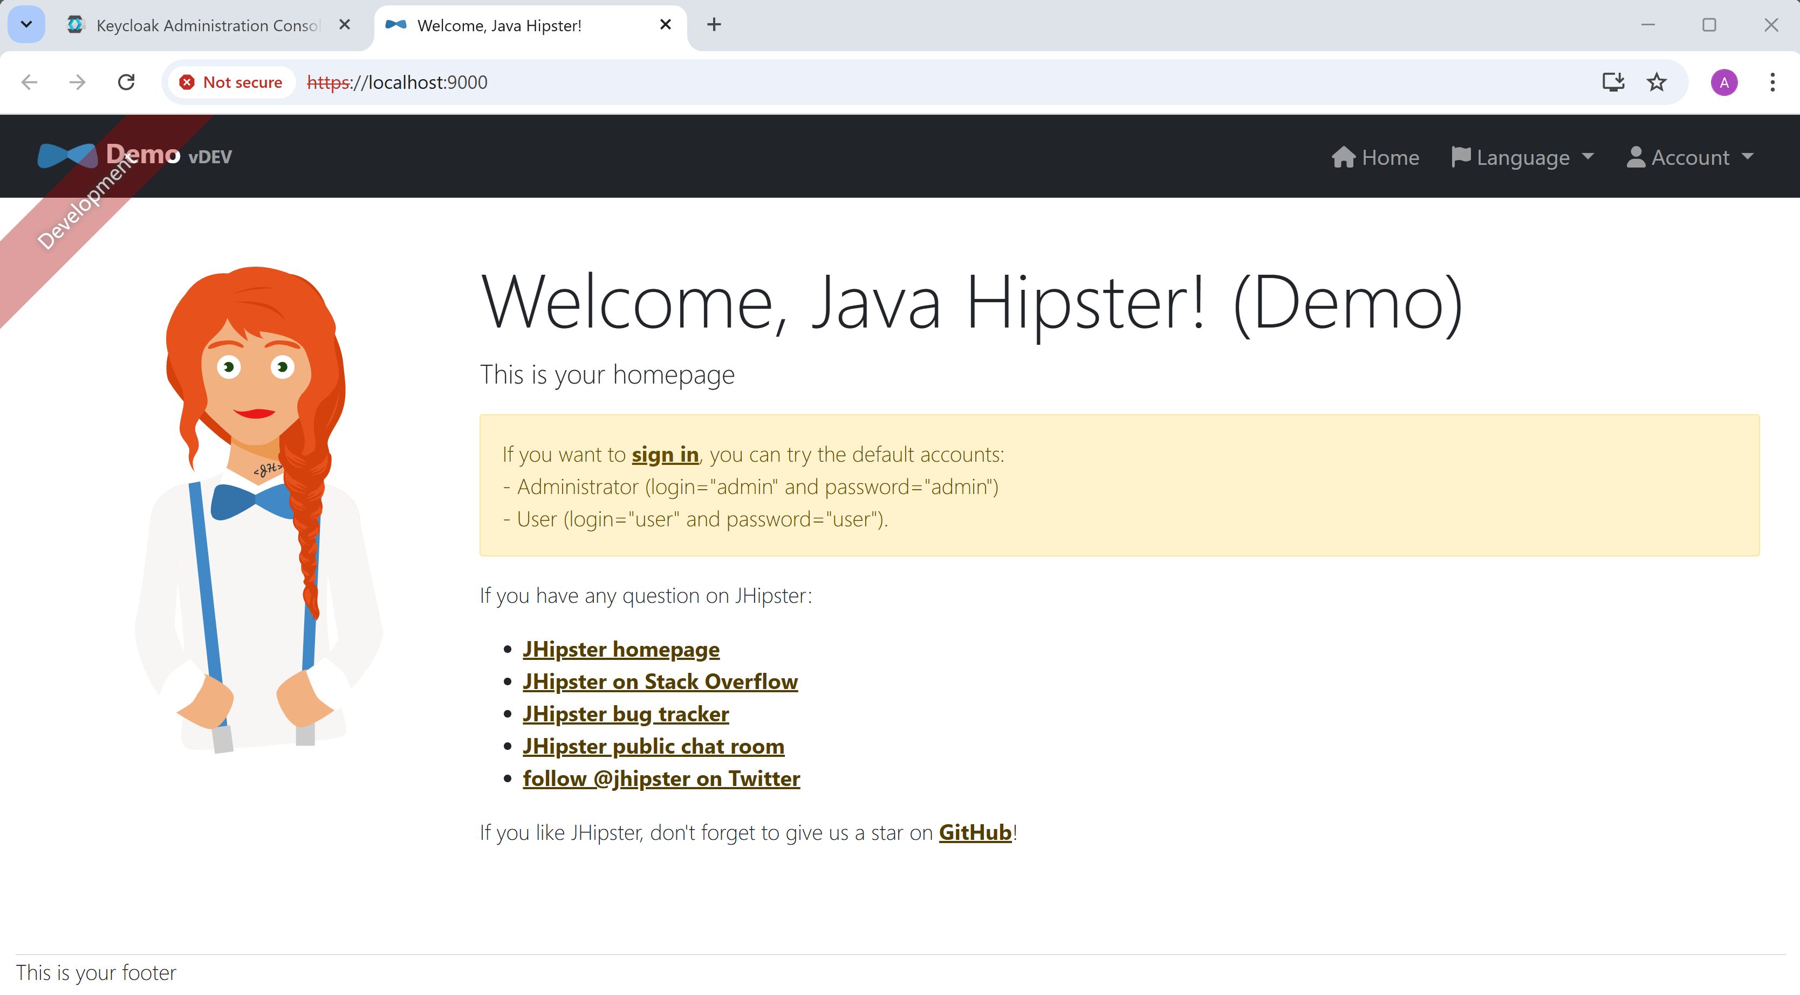
Home page: https://localhost:9000
https:// using self-signed certificate => marked as "Not secure" by chrome

Slide 22
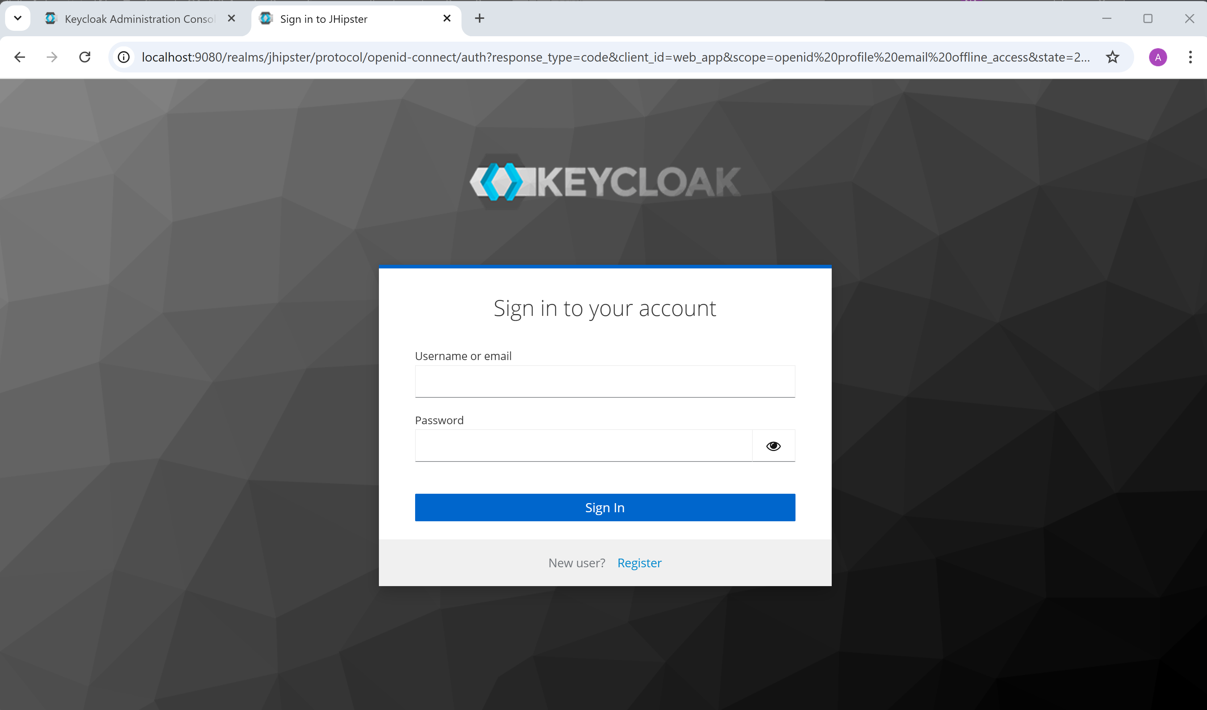
Click sign-in => redirect to login page of OAuth2

Slide 23
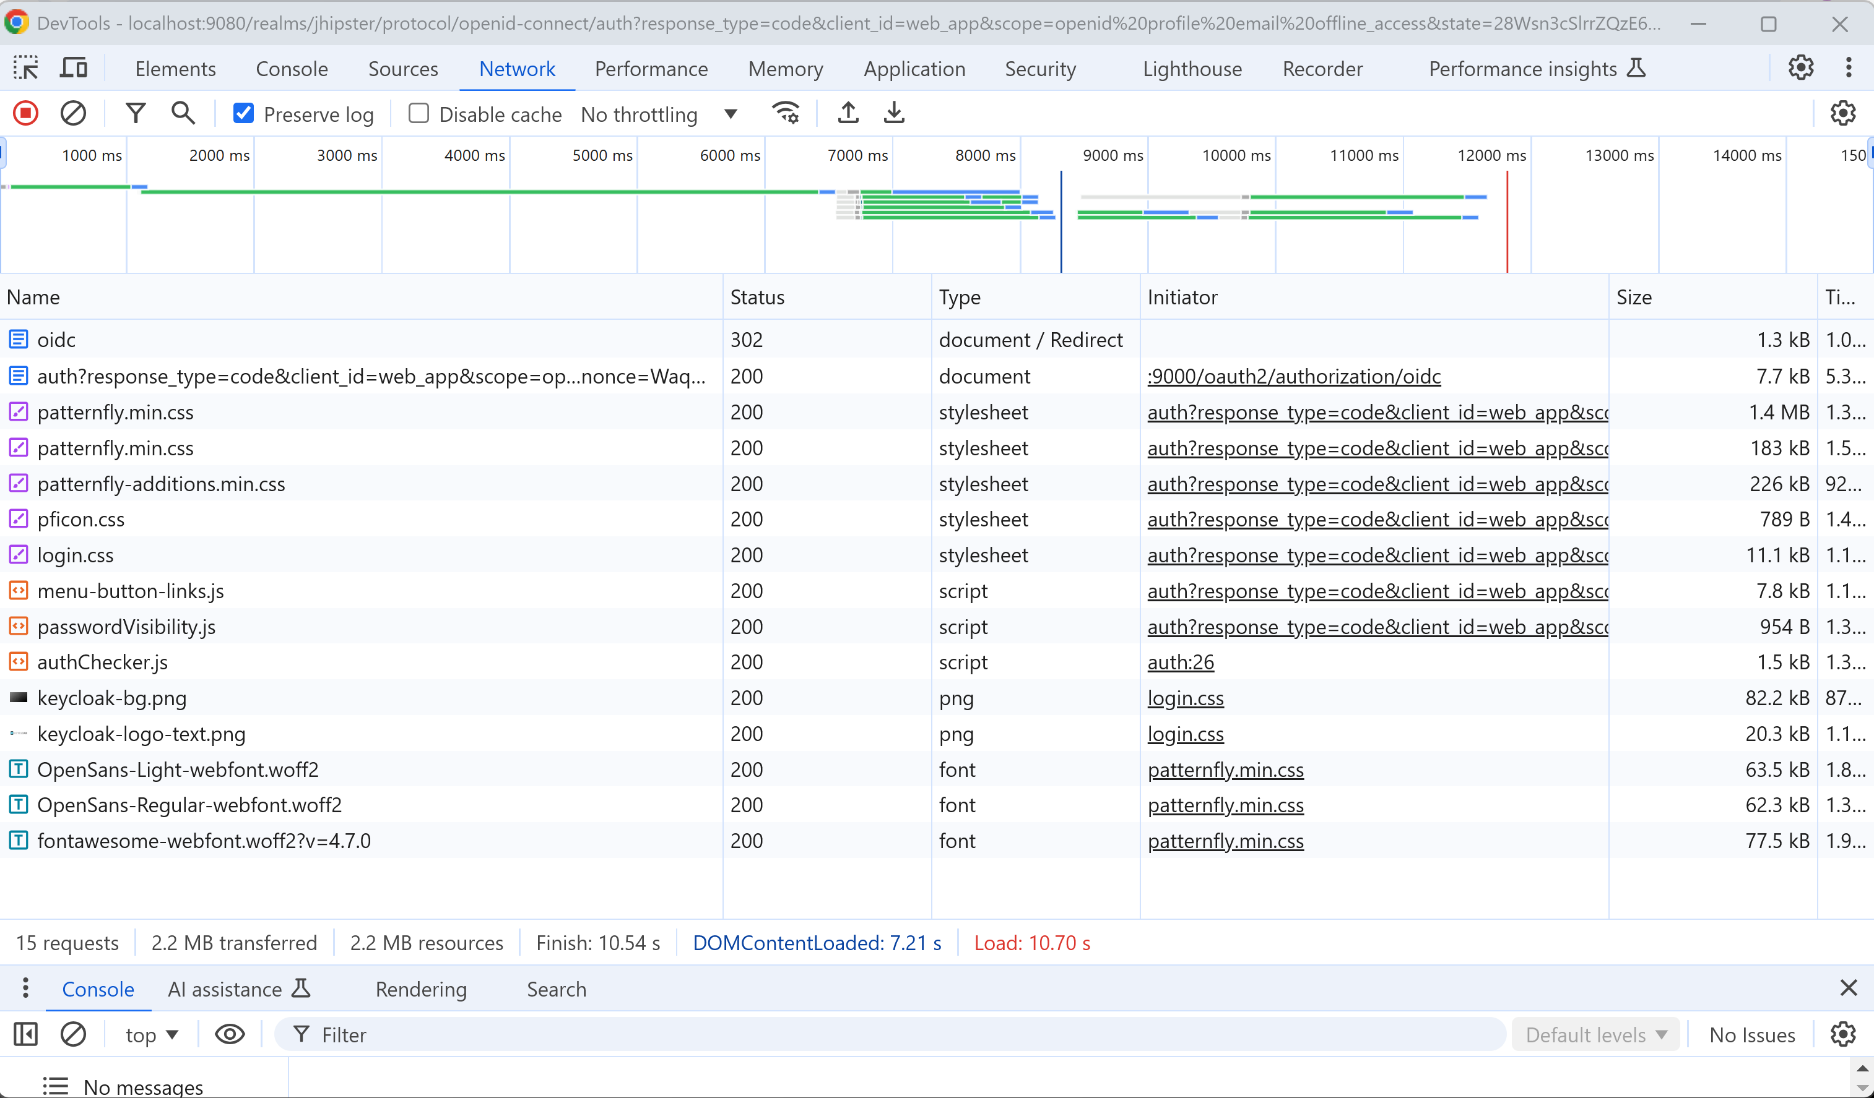
Http Request : check Chrome "Preserve Logs"

Slide 24
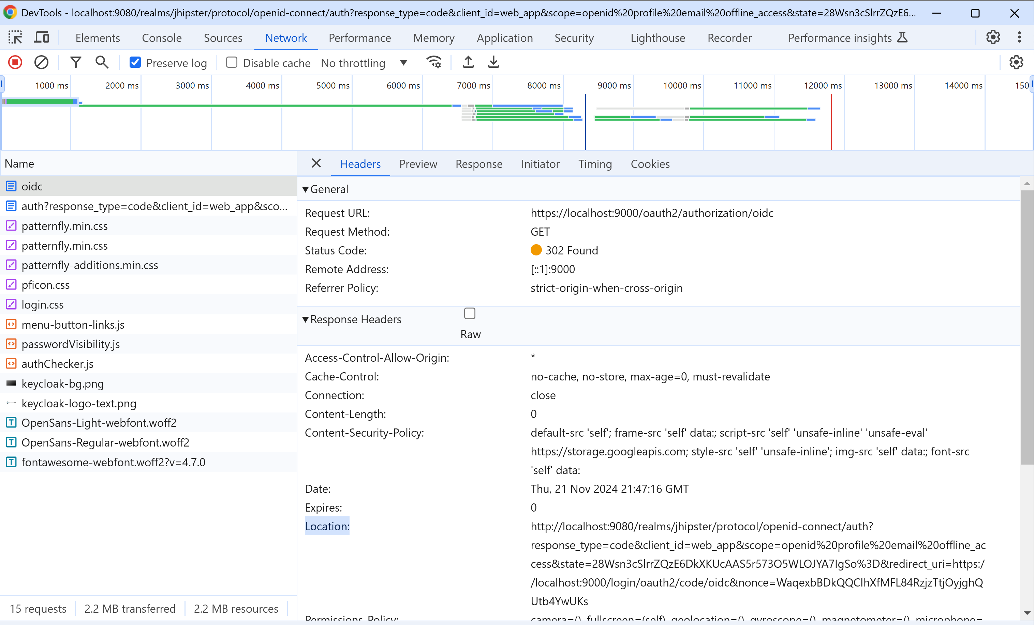
Request: Https GET "/oauth2/authorization/oidc"

Slide 25
Notice Http Status 303 + Response Header "location"
location =
http://localhost:9080/realms/jhipster/protocol/openid-connect/auth? response_type=code
&client_id=web_app
&scope=openid%20profile%20email%20offline_access
&state=28Wsn3cSlrrZQzE6DkXKUcAAS5r573O5WLOJYA7IgSo%3D
&redirect_uri=https://localhost:9000/login/oauth2/code/oidc
&nonce=WaqexbBDkQQCIhXfMFL84RzjzTtjOyjghQUtb4YwUKs
the location URL contains itself a "redirect_url" => back to origin web site after log-in

Slide 26
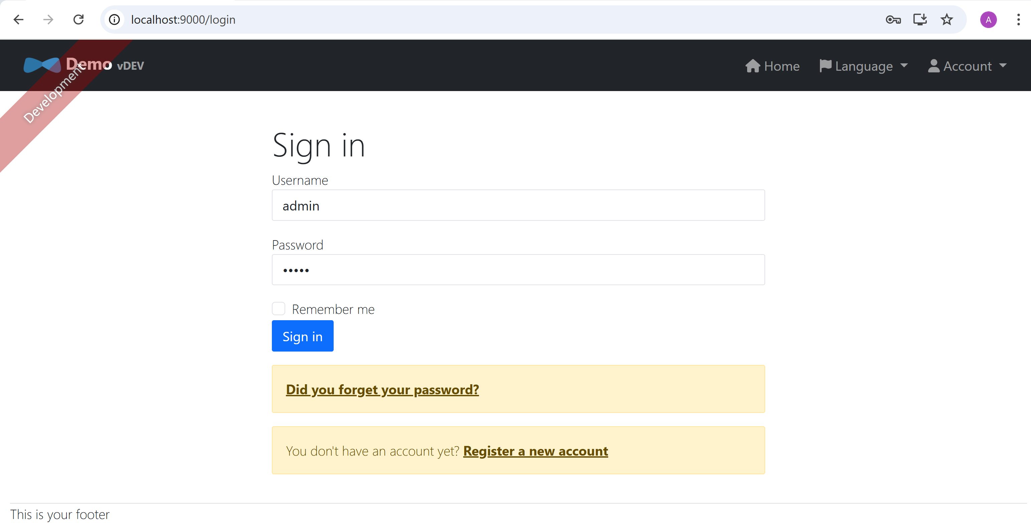
Comparison with "/login" page in JWT mode
"JWT" Mode
"OAuth2" Mode
Login Page embedded in Webapp UI
(and user-passwords database in backend application)
Login Page externalized in OAuth2 webapp UI
(and user-passwords database in OAuth2 application)

Slide 27
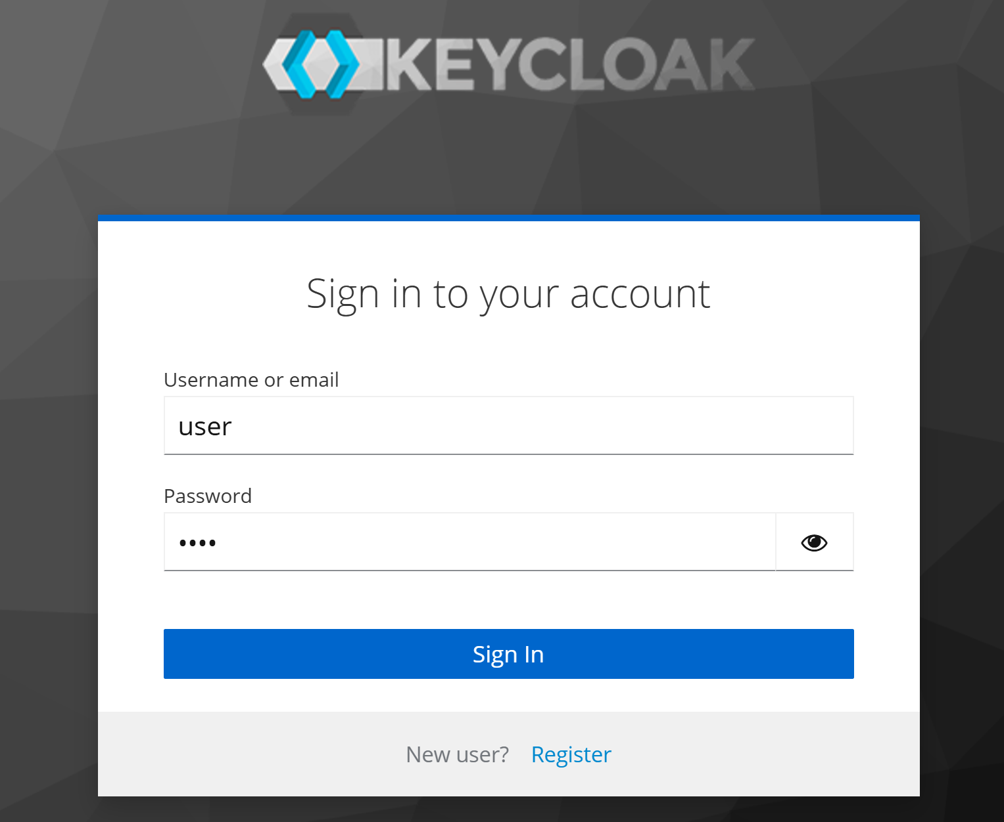
enter user-password (from OAuth2 Realm)

Slide 28
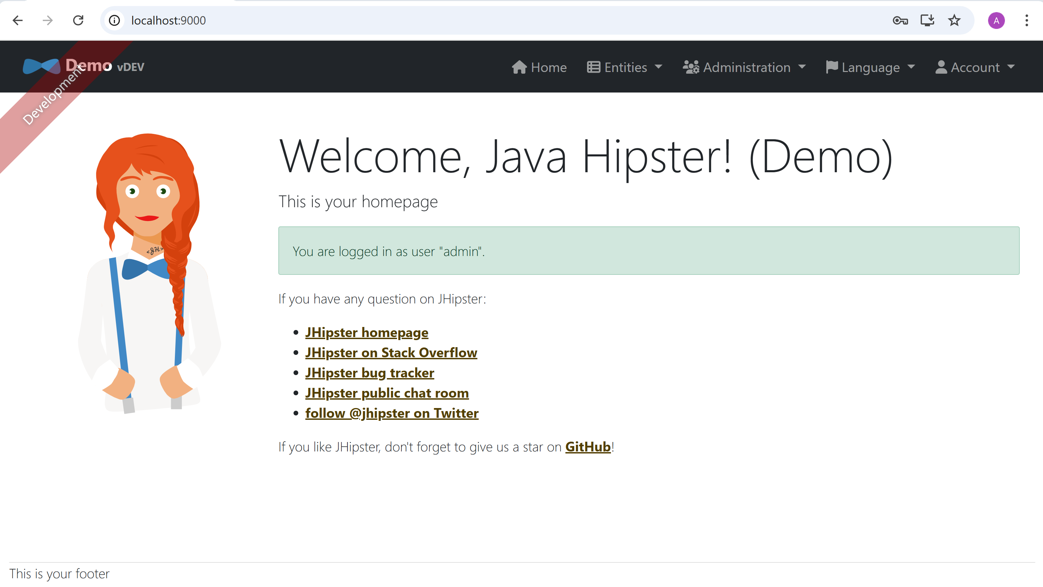
Home Page after logged-in ... redirected back to WebApp

Slide 29
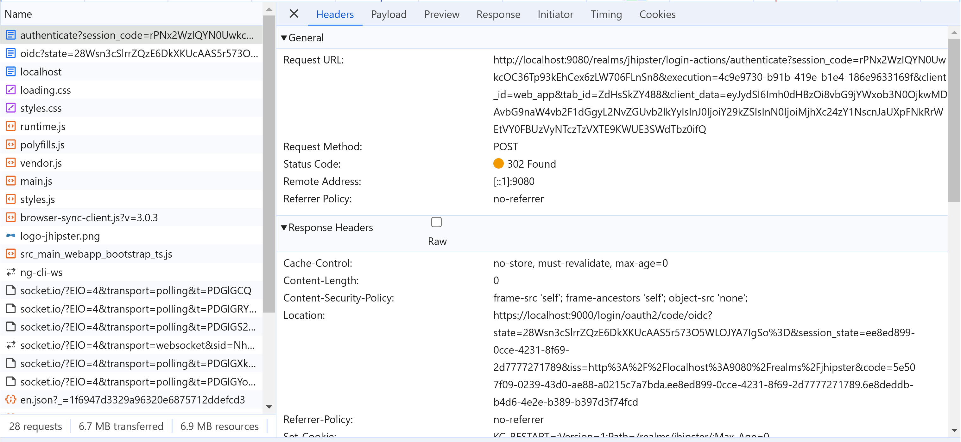
Http POST /realms/jhipster/login-actions-authenticate

Slide 30
entering back to WebApp ... OAuth2 token
Location
https://localhost:9000/login/oauth2/code/oidc
?state=28Wsn3cSlrrZQzE6DkXKUcAAS5r573O5WLOJYA7IgSo%3D
&session_state=ee8ed899-0cce-4231-8f69-2d7777271789
&iss=http%3A%2F%2Flocalhost%3A9080%2Frealms%2Fjhipster
&code=5e507f09-0239-43d0-ae88-a0215c7a7bda.ee8ed899-0cce-4231-8f69-2d7777271789.6e8deddb-b4d6-4e2e-b389-b397d3f74fcd
parameter code ... is a OAuth2 Token (not exactly a JWT format!) : 5e50----bda . ee8e---1789 . 6e8de---74fcd
it does not contains a base64 characters, but also "-", like UUID

Slide 31
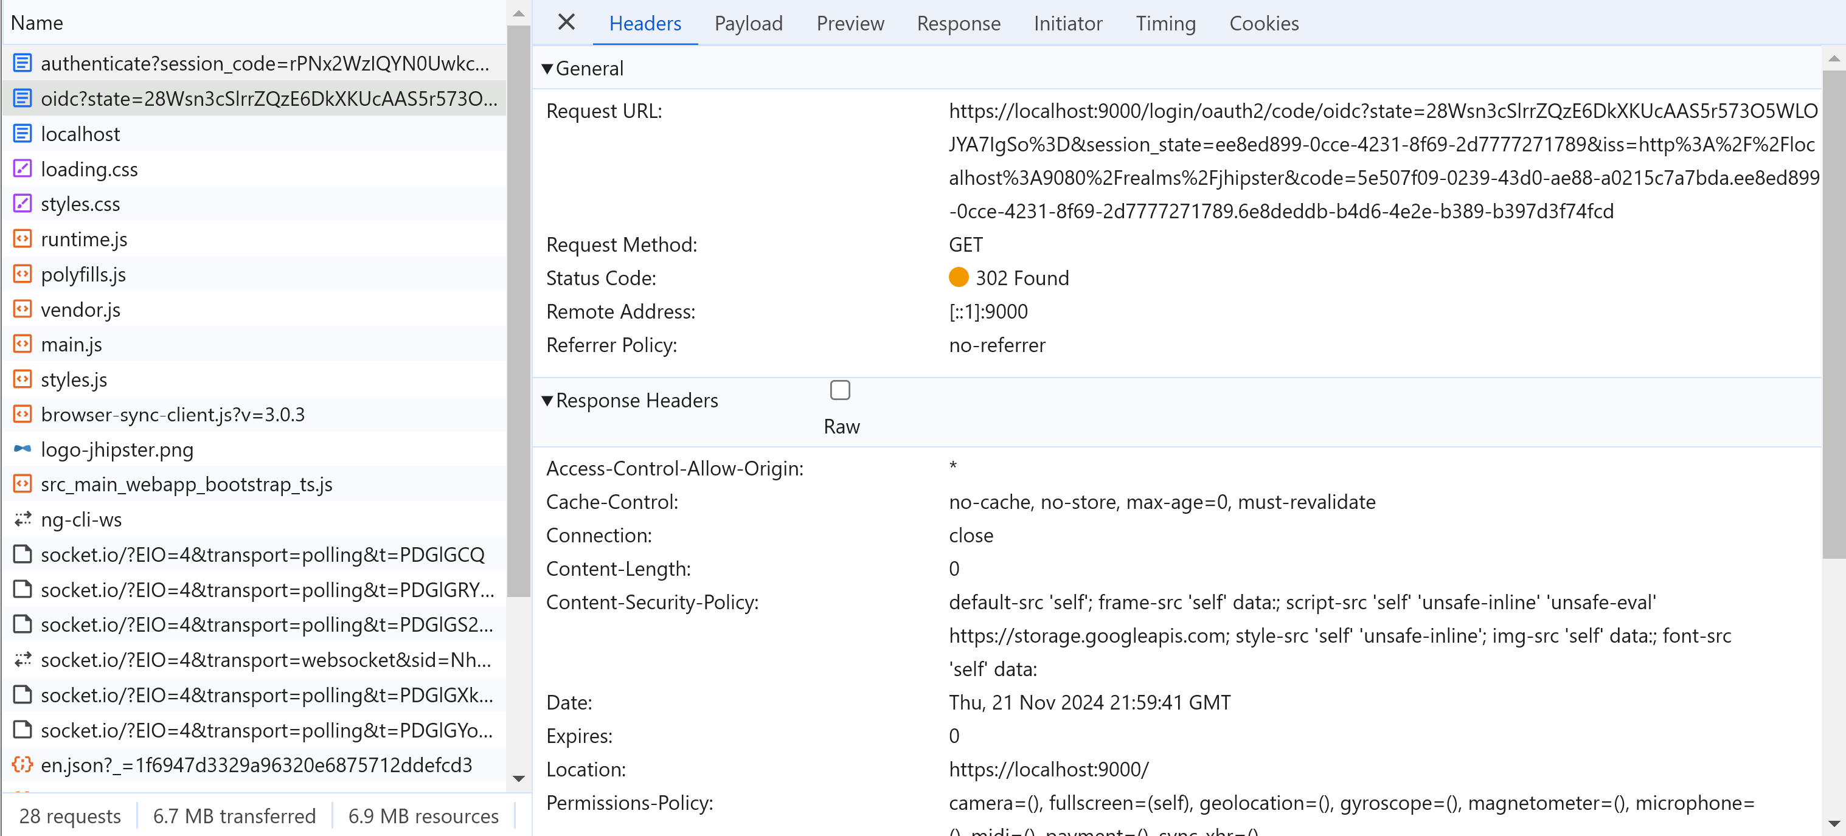
Another Request GET /login/auth2/code/oidc

Slide 32
OAuth2 token previously in Http Header "Location" => now passed as URL param
Request URL
https://localhost:9000/login/oauth2/code/oidc
?state=28Wsn3cSlrrZQzE6DkXKUcAAS5r573O5WLOJYA7IgSo%3D
&session_state=ee8ed899-0cce-4231-8f69-2d7777271789
&iss=http%3A%2F%2Flocalhost%3A9080%2Frealms%2Fjhipster
&code=5e507f09-0239-43d0-ae88-a0215c7a7bda.ee8ed899-0cce-4231-8f69-2d7777271789.6e8deddb-b4d6-4e2e-b389-b397d3f74fcd

Slide 33
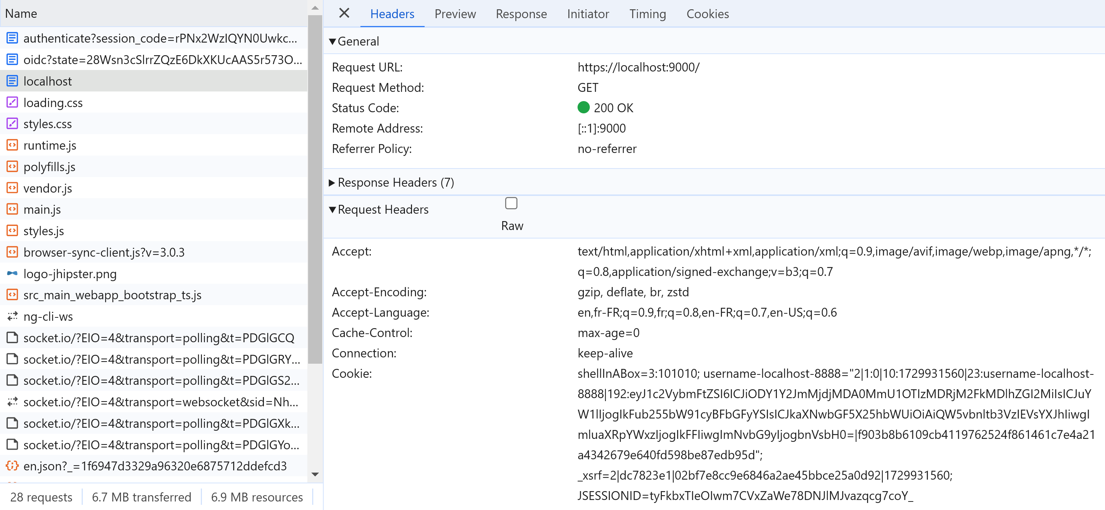
redirected to "/", with COOKIE JSESSIONID

Slide 34
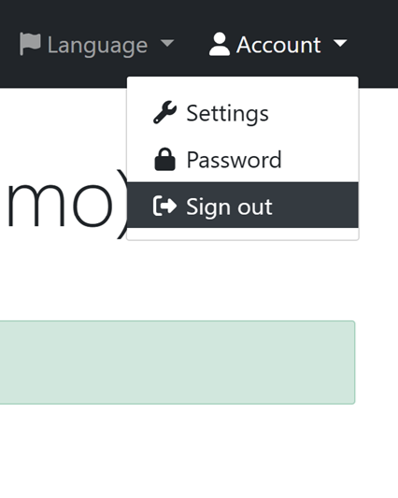
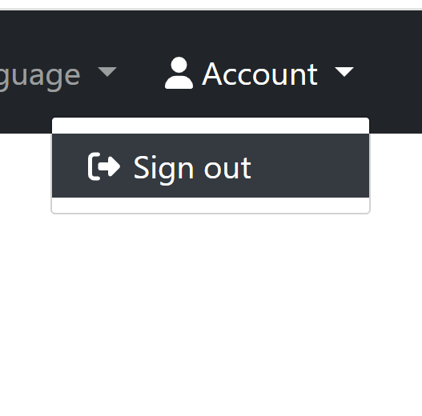
Different Menu for Account Sub Menu Item "Sessions"
"JWT" Mode
"OAuth2" Mode
user and password is NO MORE stored on webapp
=> no more menu to save
cf OAuth2 app instead

Slide 35
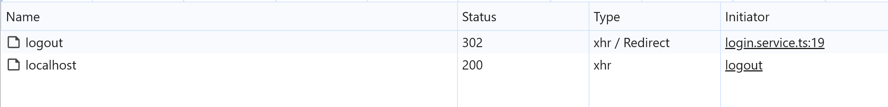
Click Sign-Out => 2 Requests

Slide 36
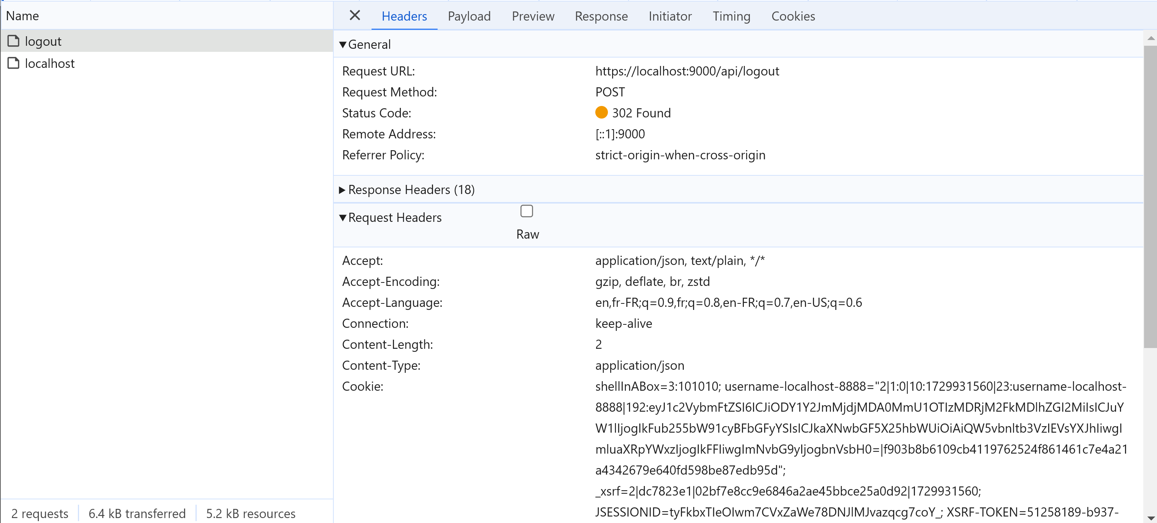
Http POST /logout

Slide 37
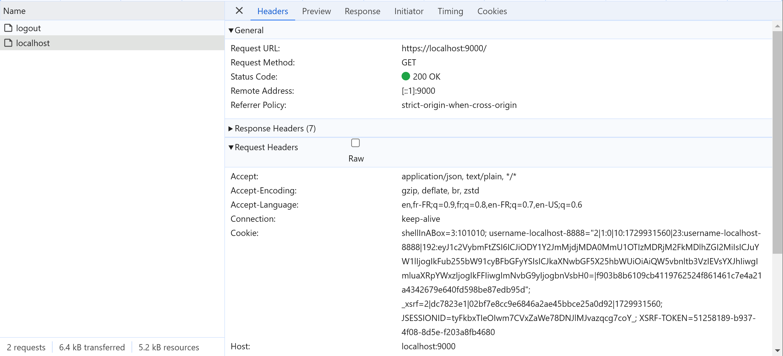
Redirected "/"

Slide 38
Authorisations
For Authorization (ROLE_*)
there is NO difference with the others mode JWT or Http SEssion.
Please see previous detailed document on JWT

Slide 39
Network & Infrastructure Deployments Options

Slide 40
Servers + OAuth2 Servers (Statefull for JESSIONID- Need Database )
OAuth2 servers
(=> OAuth2 token)
LoadBalancer
to any Server
Statefull WebApp servers
(because of JSESSIONID)

Slide 41
Take Away
[1/4]: Debugging "JWT" security mode
[2/4]: Debugging old-style COOKIE "jsessionId" security mode
[3/4]: Debugging "Basic Auth"
[4/4] Debugging the OAuth2 security mode
Security is difficult & sensitive - Leave it to experts.
Read code to learn in JHipster

Slide 42
Questions
arnaud.nauwynck@gmail.com

